Slide 1

Finding the Path
Descriptions of the “Path” class of functions

Slide 2

Many applications require a reference path
For example, roads are a form of path. The task of driving is to stay on the road, which means that a vehicle’s position relative to the path must be measured.

Slide 3
Definitions of terms are important so that we don’t get confused later
Station
Stations
Path
Paths
Traversal
Traversals

Slide 4
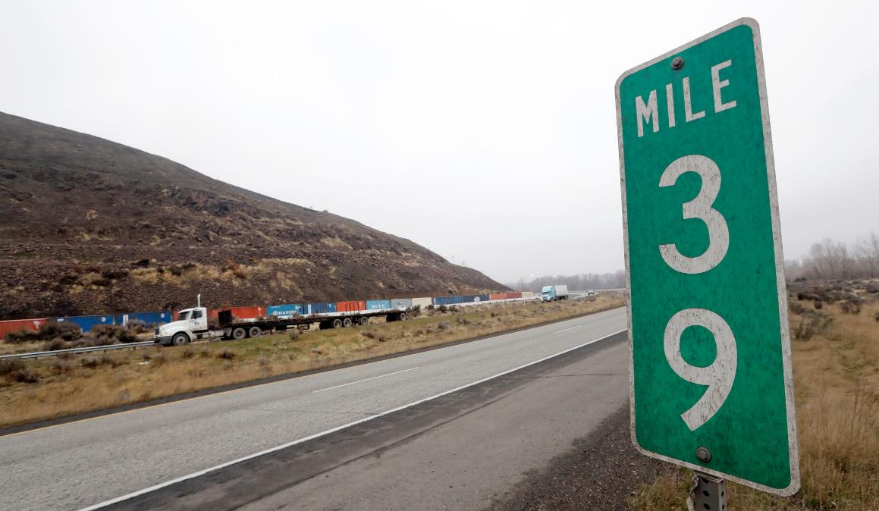
The station of a path is the location in terms of the s-coordinate along a path
For example, mile markers on a road are a station type of measurement; they do not represent distance to a specific point, but rather represent how far along a road someone has traveled relative to some start location and independent of the curvature of the road. In this case, the station is “39 miles”.
For our work, we nearly always measure station in meters.

Slide 5
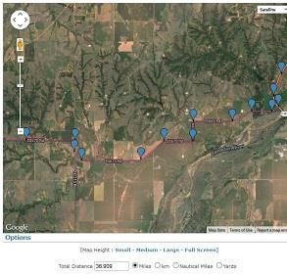
The important aspect of the station is that it does NOT depend on distance from a location.
The station distance is distance ALONG a path, so if a path is curvy, then the station distance from a point can be very large even if the point is relatively close in straight-line distance.

Slide 6
An issue with station coordinates is that they depend very strongly on how much weaving. Depending on weaving, paths plotted at same station points – in this case every 40 meters – may be very distant from their neighbors.
%% Example 2: Show station discrepancies
% Plot station markers
fig_num = 2;
figure(fig_num);
clf;
hold on;
grid on;
grid minor;
Station_step = 40;
fcn_Path_plotTraversalsXY(data,fig_num);
xlabel('X [m]');
ylabel('Y [m]');
for i_traveral = 1:length(paths)
traversal_stations = data.traversal{i_traveral}.Station;
for i_station = Station_step:Station_step:traversal_stations(end)
index = find(traversal_stations >= i_station,1);
plot(data.traversal{i_traveral}.X(index),...
data.traversal{i_traveral}.Y(index),...
'k.','Markersize',15);
text(data.traversal{i_traveral}.X(index),...
data.traversal{i_traveral}.Y(index),...
sprintf('Station: %.2f',...
data.traversal{i_traveral}.Station(index)));
end
end

Slide 7
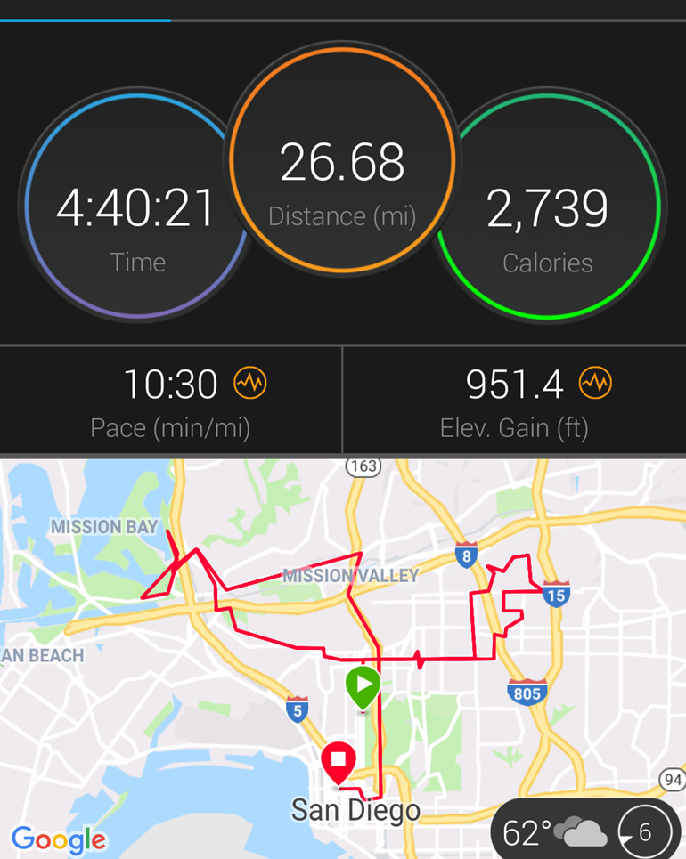
This side-side swerving is why marathon runners ALWAYS end up running more than 26.2 miles (which often surprises and annoys first-time runners)

Slide 8

Most of our challenges with vehicle guidance have to do with the fact that the station distance on one side of the road is different than on the other. We need a COMMON station for the road or lane.

Slide 9
When we operate in code, we treat station as a 1 x 1 scalar, and stations (plural) as a N x 1 vector
This way, if a function needs multiple stations, it can query the arguments for a vector ‘stations’ rather than a scalar ‘station’. So a stations type variable consists of N “station” variables stacked together.

Slide 10
What is a path?
A path is a set of [X Y] points as a N x 2 vector or array. These X Y rows denote the locations we are trying to follow which defines the path. For example:
A path type must have at least 2 rows so that a single “path segment” can be defined.
paths{1} = [
8.1797 8.6006
8.4101 15.8892
10.0230 25.5102
10.4839 39.7959];

Slide 11
What is a path segment?
One connection between vertices is called a “path segment”, and a path must have at least ONE segment

Slide 12
Some operations require at least 2 segments, and we refer to these variable types as “paths”
The use of plural is to denote a type of variable that has multiple segments. An example operation that requires multiple segments is when we need to calculate the angles between segments.
We rarely use multiple paths as we have another variable type, traversals, discussed next. So hopefully this is not confusing!
This is a path type
This is a “paths” type OR a “path” type

Slide 13
Sometimes we want more information about a path than just XY, so we define something called a “traversal”
function traversal = fcn_Path_convertPathToTraversalStructure(path,varargin)
% fcn_Path_convertPathToTraversalStructure
% Takes a Path type and creates it to a traversal structure
%
% FORMAT:
%
% traversal = fcn_Path_convertPathToTraversalStructure(path,(fig_num))
%
% INPUTS:
%
% path: an N x 2 vector of [X Y] positions, with N>=2
%
% OUTPUTS:
%
% traversal: a sttructure containing the following fields
% - X: an N x 1 vector that is a duplicate of the input X
% - Y: an N x 1 vector that is a duplicate of the input Y
% - Z: an N x 1 vector that is a zero array the same length as
% the input X
% - Diff: a [N x 2] array that is the change in X and Y
% (front-padded with [0 0])
% - Station: the XY distance as an N x 1 vector, representing
% the distance traveled up to the current point (starting with 0
% at the first point)
% - Yaw: the calculated yaw angle (radians) of each path segment
% (note: there are N-1 segments if there are N points, thus
% there are N-1 Yaw points)
% (thus - it is front-padded with NaN)
%
% (OPTIONAL INPUTS)
%
% fig_num: a figure number to plot results.
It includes subfields that are routinely used, particularly the Station and Yaw. We convert from Path to Traversals often, so a function exists that will fill in a Traversal given a Path.

Slide 14
The last major type commonly used is “traversals” which are collections of traversal variables within an array, e.g. many “paths” that are together
An example would be:
Many_traversals.traversal{1} = some_traversal;
Many_ traversals.traversal{2} = some_other_traversal;
Etc. So the variable “Many_ traversals” is a “traversals” type and contains an array of different traversals together. This variable allows us to create functions that operate on many traversals at the same time (such as plotting, averaging, variance calculations, etc.)

Slide 15
Within the list of functions is a special function whose only purpose is to confirm that variables that are passed to it meet the requirements of each type.
This is called “fcn_Path_checkInputsToFunctions”
It is often called repeatedly at the top of other codes to check that the inputs are the correct type.
function fcn_Path_checkInputsToFunctions(...
variable,variable_type_string)
% fcn_Path_checkInputsToFunctions
% Checks the variable types commonly used in the Path class to ensure that
% they are correctly formed. This function is typically called at the top
% of most Path class functions. The input is a variable and a string
% defining the "type" of the variable. This function checks to see that
% they are compatible. For example, the 'path' type variables in the class
% function are N x 2 arrays of [x y] pairs; if someone had a path variable
% called "path_example", they could check that this fit the path type by
% calling fcn_Path_checkInputsToFunctions(path_example,'path'). This
% function would then check that the array was N x 2, and if it was not, it
% would send out an error warning.
%
% FORMAT:
%
% fcn_Path_checkInputsToFunctions(...
% variable,variable_type_string)
%
% INPUTS:
%
% variable: the variable to check
%
% variable_type_string: a string representing the variable type to
% check. The current strings include:
%
% 'station' - checks that the station type is N x 1 and is a
% number.
%
% 'stations' - checks that the station type is N x 1 and is a
% number, with N >= 2
%
% 'path' - checks that the path type is N x 2 with N>=2
%
% 'paths' - checks that the path type is N x 2 with N>=3
%
% 'traversal' - checks if a structure with X, Y, and Station,
% and that each has an N x 1 vector within all of same length.
% Further, the Station field must be strictly increasing.
%
% 'traversals' - checks if a structure containing a subfield
% that is a cell array of traveral{i}, e.g. "data.traversal{3}",
% with each traversal also meeting traversal requirements.
%
% Note that the variable_type_string is not case sensitive: for
% example, 'station' and 'Station' or 'STAtion' all give the same
% result.
%
% OUTPUTS:
%
% No explicit outputs, but produces MATLAB error outputs if conditions
% not met, with explanation within the error outputs of the problem.

Slide 16
Getting started

Slide 17
We’re often creating paths, but for dummy “starter” paths we have a function
It fills in (currently) three different paths in an array, which is easily converted into a “traversals” type.
Note: a click-to-draw function also exists that allows interactive creation of paths.
END
START
% Fill in some dummy data
paths = fcn_Path_fillSamplePaths;

Slide 18
Why do we use this example? It has some challenging features that often “break” code
Each traversal has a VERY different number of points
The traversals cross each other repeatedly
They have different start/stop XY locations
Each traversal loops back on itself, which breaks Euclidean distance-based queries

Slide 19
Because the length of each traversal is different, we cannot save these as arrays (not easily, at least). So we use structure types to save traversals to allow different lengths.

Slide 20
We often collect traversal data into cell arrays called traversals. And we often need to plot them. A function exists for this.
% script_test_fcn_Path_plotTraversalsXY.m
% Tests fcn_Path_plotTraversalsXY
close all
clc
% Fill in some dummy data
paths = fcn_Path_fillSamplePaths;
% Convert paths into traversals
for i_traveral = 1:length(paths)
traversal = fcn_Path_convertPathToTraversalStructure(paths{i_traveral});
data.traversal{i_traveral} = traversal;
end
%% Call the plot command to show how it works. figure(11);
fcn_Path_plotTraversalsXY(data);

Slide 21
Similarly, we often want to plot the yaw within traversal arrays and a function exists for this too
% script_test_fcn_Path_plotTraversalsYaw.m
% tests fcn_Path_plotTraversalsYaw
clc
close all
% Fill in some dummy data
paths = fcn_Path_fillSamplePaths;
% Convert paths into traversals
for i_traveral = 1:length(paths)
traversal = fcn_Path_convertPathToTraversalStructure(paths{i_traveral});
data.traversal{i_traveral} = traversal;
end
%% Call the plot command to show how it works. First, put it into our figure
% to show that it will auto-label the axes and create a new figure (NOT
% figure 11 here) to plot the data.
figure(11);
fcn_Path_plotTraversalsYaw(data);
%% Next, specify the figure number to show that it will NOT auto-label the
% axes if figure is already given and it puts the plots into this figure.
fig_num = 12;
fcn_Path_plotTraversalsYaw(data,fig_num);

Slide 22
Basic Path Operations Include
Finding the intersection of segments:
Snapping a point onto a path:
Projecting from a path normally outward
Generating random traversals about a reference traversal
Trimming out sections of traversals given certain station points
These basic functions are described below.

Slide 23
Finding the intersection of segments

Slide 24
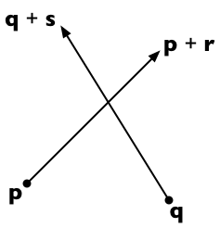
The most basic path operation is finding the intersection of a path segment rooted at p and extending to p+r, with a sensor rooted at q and extending to p+s.
Details can be found at: https://stackoverflow.com/questions/563198/how-do-you-detect-where-two-line-segments-intersect

Slide 25
This capability is implemented in fcn_Path_findProjectionHitOntoPath.m
% fcn_Path_findProjectionHitOntoPath calculates hits between a sensor
% projection and a path, returning the distance and location of the hit.
%
% FORMAT:
%
% [distance,location] = ...
% fcn_Path_findProjectionHitOntoPath(path,...
% sensor_vector_start,sensor_vector_end,...
% (flag_search_type),(fig_num))
%
% INPUTS:
%
% path: an N x 2 vector containing the X,Y points of the path to be
% checked for intersections
%
% sensor_vector_start: a 1 x 2 vector containing the X,Y points of the
% sensor's start location
%
% sensor_vector_end: a 1 x 2 vector containing the X,Y points of the
% sensor's end location
%
% (OPTIONAL INPUTS)
% flag_search_type: an integer specifying the type of search.
%
% 0: return distance and location only if the given
% sensor_vector overlaps the path (this is the default)
%
% 1: return distane and location if any projection of the sensor
% vector, in any direction, hits the path (in other words, if
% there is any intersection). Note that distance returned will
% be negative if the nearest intersection is in the opposite
% direction of the given sensor vector.
%
% fig_num: a figure number to plot results. Turns debugging on.
%
% OUTPUTS:
%
% distance: a 1 x 1 scalar representing the distance to the closest
% intersection of the sensor with the path
%
% location: a 1 x 2 vector of the X,Y location of intersection point

Slide 26
This method requires the definition of the cross product
Define the 2-dimensional vector cross product v × w to be v_{x} w_{y} − v_{y} w_{x}.
%% Calculate cross products
function result = crossProduct(v,w)
result = v(:,1).*w(:,2)-v(:,2).*w(:,1);
end

Slide 27
The method used is to consider fractions of the path and of the sensor vectors
Suppose the path segment runs from p to p + r and sensor starts from q and extends to q + s. Then any point on the first line is representable as p + t r (for a scalar parameter t) and any point on the second line as q + u s (for a scalar parameter u).

Slide 28
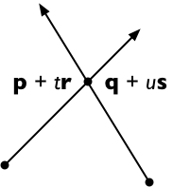
The two lines intersect if we can find t and u such that:
p + t r = q + u s
To solve, cross both sides with s, getting
(p + t r) × s = (q + u s) × s
And since s × s = 0, this means
t (r × s) = (q − p) × s
And therefore, solving for t:
t = (q − p) × s / (r × s)

Slide 29
We can solve for u similarly:
(p + t r) × r = (q + u s) × r
u (s × r) = (p − q) × r
u = (p − q) × r / (s × r)
To reduce the number of computation steps, it's convenient to rewrite this as follows (remembering that s × r = − r × s):
u = (q − p) × r / (r × s)

Slide 30
If the lines are parallel then r × s = 0
If (q − p) × r = 0, then the lines are co-linear as well. NOTE: this is NOT checked for in the code!
In this case, express the endpoints of the second segment (q and q + s) in terms of the equation of the first line segment (p + t r):
t₀ = (q − p) · r / (r · r)
t₁ = (q + s − p) · r / (r · r) = t₀ + s · r / (r · r)
If the interval between t₀ and t₁ intersects the interval [0, 1] then the line segments are collinear and overlapping; otherwise they are collinear and disjoint.
Note that if s and r point in opposite directions, then s · r < 0 and so the interval to be checked is [t₁, t₀] rather than [t₀, t₁].

Slide 31
If parallel and non-intersecting?
If r × s = 0 and (q − p) × r ≠ 0, then the two lines are parallel and non-intersecting

Slide 32
What if they intersect?
If r × s ≠ 0 and 0 ≤ t ≤ 1 and 0 ≤ u ≤ 1, the two line segments meet at the point p + t r = q + u s. Otherwise, the two line segments are not parallel but do not intersect.
Credit: this method is the 2-dimensional specialization of the 3D line intersection algorithm from the article "Intersection of two lines in three-space" by Ronald Goldman, published in Graphics Gems, page 304. In three dimensions, the usual case is that the lines are skew (neither parallel nor intersecting) in which case the method gives the points of closest approach of the two lines.

Slide 33
Intersections at the end-points of the path
If intersections occur at the end-points of a path segment, then results can be ambiguous because t = 0 or t=1. In these cases, can have weird situations if we omit this, e.g. the following:
((0<t).*(1>t).*(0<u).*(1>u));
The result of this condition is that NO intersection would be detected

Slide 34
If we correct the t-range, then the intersection is found
good_vector = ((0<=t).*(1>=t).*(0<u).*(1>u));

Slide 35
Similarly, this form with the u range not including 0 or 1 can miss paths that barely hit the sensor at start or end
Missing the origin is a particularly bad error as it would cause one to miss overlapping paths

Slide 36
Here’s the correct result
good_vector = ((0<=t).*(1>=t).*(0<=u).*(1>=u));

Slide 37
Example 1: A simple example
See: script_test_fcn_Path_findProjectionHitOntoPath.m
%% Simple test 1 - a simple intersection
fprintf(1,'Simple intersection result: \n');
path = [0 10; 10 10];
sensor_vector = [2 1; 5 15];
fig_debugging = 2343;
[distance,location] = ...
fcn_Path_findProjectionHitOntoPath(path,sensor_vector,fig_debugging);
print_results(distance,location);

Slide 38
Example 2: Not intersecting
See: script_test_fcn_Path_findProjectionHitOntoPath.m
%% Simple test 2 - no intersections
fprintf(1,'No intersection result: \n');
path = [-4 10; 2 10];
sensor_vector = [0 0; 5 12];
fig_debugging = 2343;
[distance,location] = ...
fcn_Path_findProjectionHitOntoPath(path,sensor_vector,fig_debugging);
print_results(distance,location);

Slide 39
Example 3: Multiple line segments
See: script_test_fcn_Path_findProjectionHitOntoPath.m
%% Simple test 3 - multiple intersections
fprintf(1,'Multiple intersections result: \n');
path = [0 10; 10 10; 0 6; 10 6; 0 2];
sensor_vector = [0 0; 5 12];
fig_debugging = 2343;
[distance,location] = fcn_Path_findProjectionHitOntoPath(...
path,sensor_vector,fig_debugging);
print_results(distance,location);

Slide 40
In some applications, the “length” of the sensor vector is irrelevant. One simply wants to know any location, in any direction, where an intersection could occur.
The flag_search_type variable can be set to 1 (instead of 0, default) to specify that any intersection will work. Here’s an example with a sensor vector of length 2. If an “unlimited” search is used, a hit is detected with either positive or negative distance.
flag_search_type = 0
flag_search_type = 1

Slide 41
Snapping a point onto a path

Slide 42
One of the basic path operations is snapping from a query point onto a path
The goal is to find the point ON A PATH that is “closest” to the query point. One way to do this is to find the closest vertex on a path to a query point. That closest vertex is connected to 1 or 2 other points.
If 2 points, we then check which of these 2 points is closest to the query point,
and use that to define a segment. We then project from that segment to the query point.

Slide 43
This functionality is implemented in the MATLAB function: fcn_Path_snapPointOntoPath
%% BASIC example 1.2 - works
point = [1.4 1.3]; % Define the query point
pathXY = [0 0; 0.5 0.2; 0.9 0.9; 1.5 0.6; 3 0]; % Define an XY path
pathSXY = fcn_Path_convertXYtoSXY(pathXY(:,1),pathXY(:,2)); % Convert to SXY path
fignum = 112; % Define the figure number
% Snap the point onto the path
[closest_path_point,s_coordinate,...
first_path_point_index,second_path_point_index,...
percent_along_length] = ...
fcn_Path_snapPointOntoPath(point, pathSXY,fignum);
% Print results to the workspace
fprintf(1,'Figure: %d\n',fignum);
fprintf(1,'\t\t Closest point is: %.2f %.2f \n',...
closest_path_point(1,1),closest_path_point(1,2));
fprintf(1,'\t\t Matched to the path segment given by indices %d and %d, \n',...
first_path_point_index,second_path_point_index);
fprintf(1,'\t\t S-coordinate is: %.2f, \n',...
s_coordinate);
fprintf(1,'\t\t percent_along_length is: %.2f\n',percent_along_length);
(Worspace shows)
Figure: 112
Closest point is: 1.14 0.78
Matched to the path segment given by indices 3 and 4,
S-coordinate is: 1.61,
percent_along_length is: 0.40

Slide 44
This breaks if the nearest segment is not the one with two closest endpoints
%% BASIC example 1.3 - breaks
point = [1.5 1];
pathXY = [0 0; 0.5 0.2; 0.9 0.9; 3 0];
pathSXY = fcn_Path_convertXYtoSXY(pathXY(:,1),pathXY(:,2));
fignum = 113;
% Snap the point onto the path
[closest_path_point,s_coordinate,...
first_path_point_index,second_path_point_index,...
percent_along_length] = ...
fcn_Path_snapPointOntoPath(point, pathSXY,fignum);
% Print results to the workspace
fprintf(1,'Figure: %d\n',fignum);
fprintf(1,'\t\t Closest point is: %.2f %.2f \n',...
closest_path_point(1,1),closest_path_point(1,2));
fprintf(1,'\t\t Matched to the path segment given by indices %d and %d, \n',...
first_path_point_index,second_path_point_index);
fprintf(1,'\t\t S-coordinate is: %.2f, \n',...
s_coordinate);
fprintf(1,'\t\t percent_along_length is: %.2f\n',percent_along_length);
Figure: 113
Closest point is: 1.09 1.23
Matched to the path segment given by indices 2 and 3,
S-coordinate is: 1.73,
percent_along_length is: 1.48

Slide 45
One idea to fix these errors might be to check whether the “snap” point is on a segment, but there are queries that occur where the result would be on neither segment. For example:

Slide 46
In vehicle preview-based control, the ambiguity of the snap point can cause different errors depending on whether the projection is from the path to vehicle, or vehicle to path
Vehicle
Look ahead
Vehicle
Vehicle
Snap point
Snap is orthogonal to path, e.g. projection is from path to vehicle
Snap is orthogonal to preview, e.g. projection is from vehicle to path

Slide 47
Trimming a path

Slide 48
When snapping points onto paths or traversals, if we include too much of a path, particularly one turned back toward itself, we can get incorrect snap points.

Slide 49
A fix to this problem is to trim down the traversal to include only the region we are interested in.

Slide 50
To force a query to include only a short part of a traversal, we use: fcn_Path_findTraversalStationSegment
See script_test_fcn_Path_findTraversalStationSegment.m for this demo

Slide 51
Here’s the setup and an example call
% script_test_fcn_Path_findTraversalStationSegment.m
% This is a script to exercise the function:
% fcn_Path_findTraversalStationSegment.m
% This function was written on 2020_11_16 by S. Brennan
% Questions or comments? sbrennan@psu.edu
% [traversal_trimmed,flag_outside_start, flag_outside_end] = ...
% fcn_Path_findTraversalStationSegment(...
% long_traversal, s_coord_start,s_coord_end,
% (fig_num))
% Revision history:
% 2021_01_09
% -- updated name and types to take traversal inputs
% -- added input checking
% -- added flag_do_plots
close all;
clear data;
% Fill in sample paths (as a starter)
paths_array = fcn_Path_fillSamplePaths;
% Convert paths to traversal structures
for i_Path = 1:1 % length(paths)
traversal = fcn_Path_convertPathToTraversalStructure(...
paths_array{i_Path});
data.traversal{i_Path} = traversal;
end
% Plot the results?
if 1==1
fig_num = 12;
fcn_Path_plotTraversalsYaw(data,fig_num);
fig_num = 13;
fcn_Path_plotTraversalsXY(data,fig_num);
end
%% BASIC example 1
s_coord_start = 10;
s_coord_end = 100;
fignum = 111;
[traversal_segment1,flag_outside_start, flag_outside_end] = ...
fcn_Path_findTraversalStationSegment(...
traversal, s_coord_start,s_coord_end, fignum);
fprintf(1,...
'Figure: %d, flag_outside_start is: %d, flag_outside_end is: %d \n',...
fignum, flag_outside_start,flag_outside_end);
title('Normal query - Test case #1');

Slide 52
Here are more standard example results

Slide 53
If a degenerate query is given where there is only a single station, then it automatically finds the right traversal portion containing that station
%% BASIC example 4 - degenerate within
s_coord_start = 70;
s_coord_end = 70;
fignum = 444;
[traversal_segment4,flag_outside_start, flag_outside_end] = ...
fcn_Path_findTraversalStationSegment(...
traversal, s_coord_start,s_coord_end, fignum);
fprintf(1,...
'Figure: %d, flag_outside_start is: %d, flag_outside_end is: %d \n',...
fignum, flag_outside_start,flag_outside_end);
title('Query with exact same point');

Slide 54
And if the ENTIRE traversal is within the station limits, it simply returns the entire traversal back
%% BASIC example 5 - entire traversal within
s_coord_start = -5;
s_coord_end = 7000;
fignum = 555;
[traversal_segment5,flag_outside_start, flag_outside_end] = ...
fcn_Path_findTraversalStationSegment(...
traversal, s_coord_start,s_coord_end, fignum);
fprintf(1,...
'Figure: %d, flag_outside_start is: %d, flag_outside_end is: %d \n',...
fignum, flag_outside_start,flag_outside_end);
title('Query where entire traversal within start and end of s-limits');

Slide 55
If the station end query is past the end of the traversal, but start is within, it returns only the cut-out portion
%% BASIC example 6 - end of traversal out
s_coord_start = 200;
s_coord_end = 7000;
fignum = 666;
[traversal_segment6,flag_outside_start, flag_outside_end] = ...
fcn_Path_findTraversalStationSegment(...
traversal, s_coord_start,s_coord_end, fignum);
fprintf(1,...
'Figure: %d, flag_outside_start is: %d, flag_outside_end is: %d \n',...
fignum, flag_outside_start,flag_outside_end);
title('Query where end point outside of s-limits of traversal');

Slide 56
Similarly, if the station start query is before the start of the traversal, but end is within, it returns only the cut-out portion
%% BASIC example 7 - start of traversal out
s_coord_start = -200;
s_coord_end = 100;
fignum = 777;
[traversal_segment7,flag_outside_start, flag_outside_end] = ...
fcn_Path_findTraversalStationSegment(...
traversal, s_coord_start,s_coord_end, fignum);
fprintf(1,...
'Figure: %d, flag_outside_start is: %d, flag_outside_end is: %d \n',...
fignum, flag_outside_start,flag_outside_end);
title('Query where start point outside of s-limits of traversal');

Slide 57
If both the start and end of query are BEFORE the start, then it returns only the first segment
%% BASIC example 9 - outside of start
s_coord_start = -200;
s_coord_end = -100;
fignum = 999;
[traversal_segment9,flag_outside_start, flag_outside_end] = ...
fcn_Path_findTraversalStationSegment(...
traversal, s_coord_start,s_coord_end, fignum);
fprintf(1,...
'Figure: %d, flag_outside_start is: %d, flag_outside_end is: %d \n',...
fignum, flag_outside_start,flag_outside_end);
title('Query where start and end points are prior to start of traversal');

Slide 58
Similarly, if both the start and end of query are AFTER the end, then it returns only the last segment
%% BASIC example 10 - outside of end
s_coord_start = 2000;
s_coord_end = 3000;
fignum = 1111;
[traversal_segment10,flag_outside_start, flag_outside_end] = ...
fcn_Path_findTraversalStationSegment(...
traversal, s_coord_start,s_coord_end, fignum);
fprintf(1,...
'Figure: %d, flag_outside_start is: %d, flag_outside_end is: %d \n',...
fignum, flag_outside_start,flag_outside_end);
title('Query where start and end points are after the end of traversal');

Slide 59
This function will still give the correct result if the start and end points are out of order, but will generate a warning

Slide 60
Projecting from a path normally outward

Slide 61
A common operation is to seek vectors that are normal to a path at given station points
This is used in calculating nearby paths, in projecting paths sideways, and similar operations

Slide 62
This capability is implemented in fcn_Path_findProjectionHitOntoPath.m
function [unit_normal_vector_start, unit_normal_vector_end] = ...
fcn_Path_FindOrthogonalPathVectorsAtStations(stations,central_traversal, varargin)
% fcn_Path_FindOrthogonalPathVectorsAtStations
% Given a central traversal and a set of stations along that traversal,
% finds the unit normal vector on the central traveral at each station
% point.
%
% FORMAT:
%
% [unit_normal_vector_start, unit_normal_vector_end] = ...
% fcn_Path_FindOrthogonalPathVectorsAtStations(...
% stations,central_traversal,...
% (flag_rounding_type),(fig_num));
%
% INPUTS:
%
% stations: an N x 1 vector containing the station on the central
% traversal where the projections should take place
%
% central_traversal: a traversal structure that specifies the path
% where projections to other paths are taking place.
%
% (OPTIONAL INPUTS)
% flag_rounding_type: a flag to indicate which type of projection is
% used, especially when stations are located at the end-points of
% segments within the nearby_traversal. When stations are at the
% end-points of segments, the normal vector is undefined as it depends
% on whether to use the prior or subsequent segment, or some
% combination of these.
%
% Note that the very first point always uses projections from the
% following segement, and the very last point always uses the prior.
% Otherwise, the flag determines behaviors for endpoints of internal
% segments. The options include:
%
% flag_rounding_type = 1; % This is the default, and indicates
% that the orthogonal projection of an endpoint is created by the
% PRIOR segment leading up to each station query point.
%
% flag_rounding_type = 2; % This indicates that the orthogonal
% projection of an endpoint is created by the FOLLOWING segment
% after each station query point.
%
% flag_rounding_type = 3; % This indicates that the orthogonal
% projection, ONLY if the station query falls at the joining point
% between two segments (e.g. is on the "joint"), then the
% projection is created by averaging the vector projections
% created from the PRIOR segment and FOLLOWING segment.
%
% flag_rounding_type = 4; % This indicates that the orthogonal
% projections along segments should be calculated at the midpoints
% of each segment, and then for each station qeuary, the vector
% projections are interpolated from their prior and subsequent
% vectors.
%
% fig_num: a figure number to plot results. Turns debugging on.
%
% OUTPUTS:
%
% unit_normal_vector start: a Nx2 vector containing [X1 Y1]
% coordinates as columns, where the [X1 Y1] represents the location of
% the start point of the vector, on the path.
%
% unit_normal_vector_end: a Nx2 vector containing the [X2 Y2] location
% of the end point of the unit vector. On both outputs, there are N
% rows, one row for each station.
%

Slide 63
Here are some examples:
See: script_test_fcn_Path_FindOrthogonalPathVectorsAtStations.m

Slide 64
Particularly at an internal vertex, it can be very unclear what to use as a normal vector. Here are 4 options that 1) use previous, 2) use following, 3) average both only at vertex, and 4) average everywhere

Slide 65
Generating random traversals

Slide 66
Using normal projections, a common task is to generate random traversals about a given traversal
See: fcn_Path_fillRandomTraversalsAboutTraversal.m and script_test_fcn_Path_fillRandomTraversalsAboutTraversal.m

Slide 67
One can choose different smoothness factors or the number of trajectories produced

Slide 68
One can change the standard deviations

Slide 69
One can also change the number of points to use to generate each random traversal

Slide 70
Plotting variance bands about a traveral

Slide 71
The orthogonal projections can also be used to plot the standard deviation about a traversal
See: script_test_fcn_Path_plotPathXYWithVarianceBands.m

Slide 72
Note that this function, fcn_Path_plotPathXYWithVarianceBands inherets the band color from plotting, so that multiple traversals can be put on the same figure.

Slide 73
Calculating the variance of a traversal

Slide 74
The variance of a single traversal is a measure of how much it bends at each segment, as a distance offset.
This is useful to estimate the error in decimation of a path, as this variance becomes smaller with finer decimations.
See: script_test_fcn_Path_calcSingleTraversalStandardDeviation

Slide 75
Path Averaging Methods

Slide 76
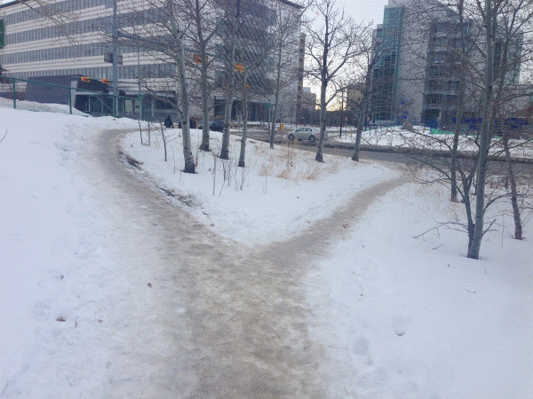
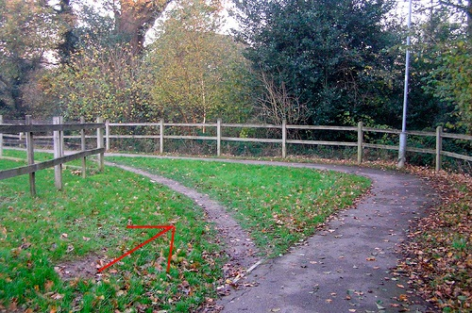
One of the more useful ways to create permanent paths is to average ones followed earlier. These naturally occurring paths are called “desire lines”.

Slide 77
The averaging process seems obvious, but it depends on metrics of distance
There are many!
Averaging points with the same station for different paths
Averaging the closest points from other paths to given points
Averaging points found by orthogonal projection from a path

Slide 78

This discrepancy in station distances is why lanes on track and field have staggered starts. The inside line would be shorter than the outside lane if everyone started at the same line.

Slide 79
The “closest point” method finds the closest point on a nearby path to the central path. It then finds the associated line segment on the nearby path, and then projects FROM the line segment back to the central path.
Note: the figures in this section can be produced by running: script_test_fcn_Path_findClosestPointsFromPath.m

Slide 80
This method has the advantage of generating expected results even when the queries “graze” nearby paths

Slide 81
But this method gives unexpected results when the segment’s closest location is not actually on the segment.

Slide 82
Generally, the “closest point” method gives expected results when applied to adjacent paths

Slide 83
The problem with closest point is that the directions of the contributions can be unclear, e.g. the nearby path may be ahead or behind the station points on the central path.

Slide 84
Orthogonal projection takes a “central” trajectory, and then projects orthogonally from that trajectory at given stations to find where it hits nearby trajectories.
%% BASIC example 1 - parallel lines, query is in middle area
stations = 1; % Define the station
% Create a dummy central path and convert it to a traversal
central_path = [0 0; 2 0];
central_traversal = fcn_Path_convertXYtoTraversalStructure(central_path(:,1),central_path(:,2));
% Define a "nearby" path and convert it to a traversal
nearby_path = [0 4; 2 4];
nearby_traversal = fcn_Path_convertXYtoTraversalStructure(nearby_path(:,1),nearby_path(:,2));
% Calculate the closest point and distance on the nearby path
[closest_path_point,distances] = ...
fcn_Path_FindOrthogonalHitFromPathToPath(stations,central_traversal,nearby_traversal);
print_results(stations,closest_path_point,distances);

Slide 85
The approach gives the intersection point for arbitrary segments nearby the central trajectory
%% BASIC example 2 - angled line segment adjacent to endpoint query
stations = 1;
central_path = [0 0; 2 0];
central_traversal = fcn_Path_convertXYtoTraversalStructure(central_path(:,1),central_path(:,2));
nearby_path = [0 4; 2 7];
nearby_traversal = fcn_Path_convertXYtoTraversalStructure(nearby_path(:,1),nearby_path(:,2));
[closest_path_point,distances] = ...
fcn_Path_FindOrthogonalHitFromPathToPath(stations,central_traversal,nearby_traversal);
print_results(stations,closest_path_point,distances);

Slide 86
We define a “miss” to even include “grazing” from one trajectory to another
%% BASIC example 3 - angled line segment adjacent to endpoint query but near-miss
stations = 10;
central_path = [0 0; 10 0];
central_traversal = ...
fcn_Path_convertXYtoTraversalStructure(central_path(:,1),central_path(:,2));
nearby_path = [0 4; 10 7];
nearby_traversal = ...
fcn_Path_convertXYtoTraversalStructure(nearby_path(:,1),nearby_path(:,2));
[closest_path_point,distances] = ...
fcn_Path_FindOrthogonalHitFromPathToPath(stations,central_traversal,nearby_traversal);

Slide 87
A challenge with query stations is that the orthogonal projection is unclear. At the start and end, we use the segment ahead and behind these points.
NOTE: the code for the images here and in the next few slides can be found in: script_test_fcn_Path_FindOrthogonalHitFromPathToPath.m

Slide 88
As noted before in the orthogonal projection, the normal vectors are unclear at vertex points, and the path intersections can change depending on which type of averaging is used.

Slide 89
The same challenge arises for queries to the involuted area

Slide 90
One result of this process is that some areas of a nearby path may receive very poor sampling. Generally, portions of nearby paths that are parallel are sampled well, but perpendicular are not.

Slide 91
For orthogonal projection, the option of averaging at the vertex appears to give the best results

Slide 92
The key advantage of the orthogonal projection is that every query “cuts” adjacent paths as one would expect.

Slide 93
The function, fcn_Path_FindOrthogonalScatterFromPathToPaths implements this cutting process at given stations
See: script_test_fcn_Path_FindOrthogonalScatterFromPathToPaths for examples

Slide 94
This allows one to average adjacent paths along each cut to produce an average path.
This is implemented in fcn_Path_findAveragePathViaOrthogonalProjection.m

Slide 95
The process of averaging has to avoid averaging paths that are nearby but not adjacent in the s-coordinate. Otherwise, the average will bias toward the alternate paths and may even “wander” at the intersections.
script_test_fcn_Path_findAveragePath.m

Slide 96
To force a query to include only a short part of a path, we use: fcn_Path_findPathSXYSegment.m as mentioned earlier.
See script_test_fcn_Path_findPathSXYSegment for this demo

Slide 97
A comparison of the averaging methods shown here reveals that orthogonal projection cross-sections appear to work the best
See: script_test_fcn_Path_findAveragePath.m

Slide 98
Note that the orthogonal averaging function has the additional outputs of distance and XY hit points of the nearby paths, which allow statistics, detailed point analysis, and advanced plotting.
See: script_test_fcn_Path_findAveragePath

Slide 99
What is an elevated path?
An elevated path is a set of [X Y Z] points as a N x 3 vector or array. These X Y Z rows denote the locations we are trying to follow which defines the elevated path. For example:
An elevated path type must have at least 2 rows so that a single “path segment” can be defined.
paths{1} = [
8.1797 8.6006 0.1
8.4101 15.8892 0.2
10.0230 25.5102 -0.1
10.4839 39.7959 0.3];

Slide 100
fcn_Path_addElevationToPath adds elevation to a `path’ by finding two nearest neighbors in an `elevated path’ and interpolating their elevations
Npoints = length(path(:,1)); % number of points in the path
% Initialize vectors to store
% 1) indices of nearest neighbor that is behind the points of path
% 2) indices of nearest neighbor that is ahead of the points of path
% 3) percentage of travel of point on the path
vector_first_path_point_index = NaN(Npoints,1);
vector_second_path_point_index = NaN(Npoints,1);
vector_percent_along_length = NaN(Npoints,1);
for i = 1:Npoints
[~, ~, vector_first_path_point_index(i), ...
vector_second_path_point_index(i), vector_percent_along_length(i)] ...
= fcn_Path_snapPointOntoNearestPath(path(i,:), reference_elevated_path(:,[1,2]));
end
% estimate the elevation as an average
elevation = (1-vector_percent_along_length).*reference_elevated_path(vector_first_path_point_index,3)+...
vector_percent_along_length.*reference_elevated_path(vector_second_path_point_index,3);
elevated_path = [path, elevation];

